Slide 1

‘Risk’ & ‘AGILE’ The perfect mix?
AGILE
Risk
Mix
Content is based on my ‘witness experience’ and opinion and does not express the opinion of previous employers or clients
Notes:
For the people who know Agile just a little bit, I’m sure that you’re thinking ‘hmmm, is the perfect mix between Risk and Agile really a hit???’, well, the answer is like all of them ‘It depends …’. Agile should not be seen as a ‘methodology’, it should not be seen as another attempt to ‘LEAN’ processes or that you should put ‘KANBAN’ boards everywhere and follow your progress on those. No, Agile is all of that and much more… It entails a mindset which is soo much more difficult to implement in an organization, it entails discipline but based on delegation of responsibilities, it entails ‘taking ownership’ and yes, also the ownership of your risks.

Slide 2

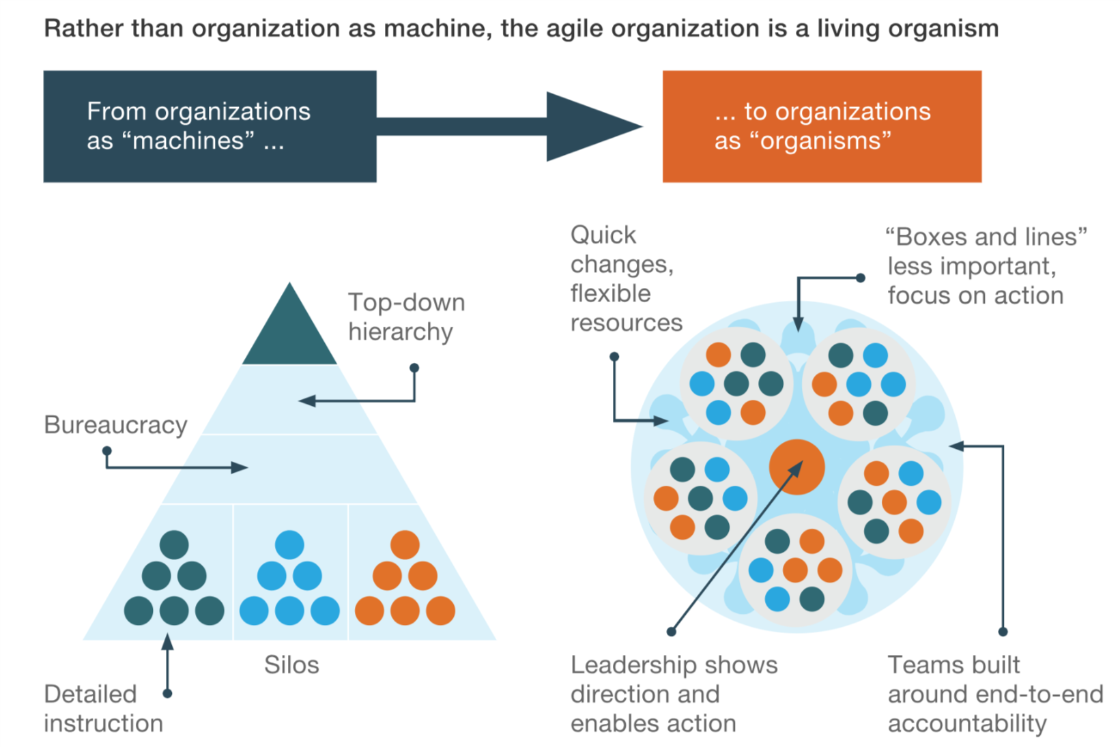
What’s AGILE all about?
* Source: McKinsey: https://www.mckinsey.com/business-functions/organization/our-insights/the-five-trademarks-of-agile-organizations
Notes:
Just as a quick introduction on ‘how is AGILE different from our normal ‘Waterfall approach’. Well, in my view, because waterfall is a project methodology, and Agile is a business model. Agile goes beyond the ‘change’ part of your organization, it also includes everuthing which is considered as ‘run’ activities. What you saw before where silo’s as in a series of actions hwich needs to be taken for each change to go in production, and where for each step, you needed to go to a different team or evene department to get just that ‘one step’ done. Agile is different in that aspect as it tries to combine all the skills and knowledge you need to make a change to a ‘customer product’ in one squad. The squad organizes itself as it knows the end objective and acts as a team. How do they organize themwelves, well … THEY TALK to each other. As they have business knowledge as well as functional and technical knowledge available within the team, they can also be able to adjust if necessary. If somehting urgent comes up, the business representative can intervene and change priorities. This business rep is called the ‘PO’. Now, the fact that you have all of that together combined in one team, makes you very flexible and let’s you set priorities which are beneficial for the company end workable for your IT. And how do we ensure those teams work? Well, there is no manager per team anymore, but the whole team is accountable for the end-result.

Slide 3

Processes and Tools
Individuals & interactions
Comprehensive documentation
Working software
DO NOT CROSS - DO NOT CROSS - DO NOT CROSS - DO NOT CROSS - DO NOT CROSS
Contract negotiation
Customer collaboration
Following a plan
Responding to change
Notes:
Why would I understand that some of you aren’t jumping up and down being euforic when hearing about AGILE, well, here are some of the sayings that I think made you doubt seriously as a risk manager.

Slide 4

How is it set up?
X-functional team
TRIBE
Collection of squads aligned with the business / customer
Squad
Squad
Squad
Self-steering
Coaching Knowledge sharing
Chapter
Expertise group
Agile coach
Notes:
If we now look at how AGILE has been implemented within Banks, we need to take a moment to step back and consider that the organizations I’m talking about have between 8.000 and 15000 employees working for them. And when I say that AGILE is a mindset and way of working, this means that everybody has to jump into the experience. So, how has this been done in a nutshell:
The banks have taken a look at the end customer and their product range and then analysed which teams / people / tools they had to put together in order to bring value to the customer.
- They have divided the IT part up into ‘Tribes’ in which the people and assets are grouped which can bring forth a change without having to go too much to other ‘tribes’ for assistance.
Some banks have drawn this through to the business (client facing) aspect of the bank as well and called them something like ‘Circles’ whereby they also use the AGILE way of working in their daily processing and internal changes (e.g. process optimization)
For the sake of time I will focus a bit more on the IT side of things…
In each tribe they have defined chapters, which are groups of people having specific knowledge and skills. Beware that this is just a more ‘functional given’ as they do not work together necessarily on a daily basis. Chapters are there to ensure that knowledge remains at a high level and is shared between the people
Then they have defined the ‘Squads’ which are groups of people who can actually create a change which add value to the customer whithout too much interaction or iteration from outside of their squad
As such, a tribe is a collection of teams being able to bring value to the customer
Explain:
Squads can be formed around 1 asset or a group of assets which can more or less on its own create a (full)

Slide 5




What’s Risk Management all about?
Identify & assess
Risk treatment
Monitor & report
Notes:
Describe what is Risk all about. What do we all work for?

Slide 6
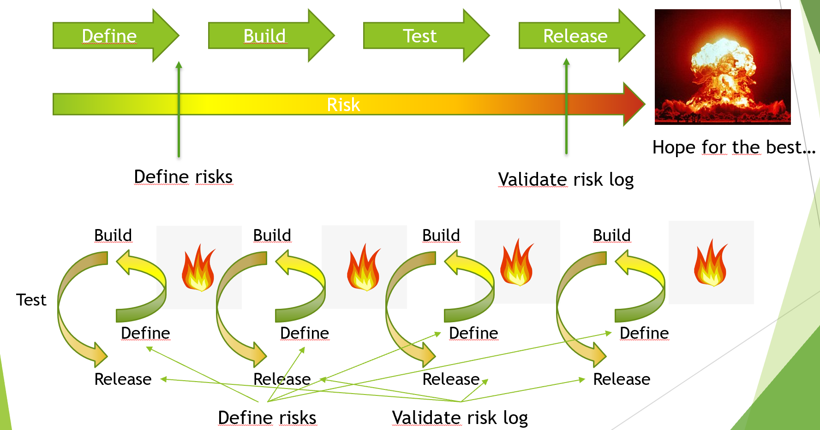
Risk management Transition to Agile
Notes:
When working in Waterfall, you have a defined track to follow when you want to make a large change or complete a project. You create everything in one big block, test it all at once and when a small thing fails, you can start again. And when finally you get to a realease, it’s fingers crossed that your production environment is not different from your acceptance environment. In an Agile environment, you would have been able to detect the error sooner.You would have been able to show partial deliverables but also working products to your stakeholders and even test it on your clients. As you work in small increments, you can develop faster, adjust faster and even change some specs along the way. Same goes for your risk identification and mitigation, in stead of having 1 moment to do the assessment, you can (need to) do this at several instances.

Slide 7

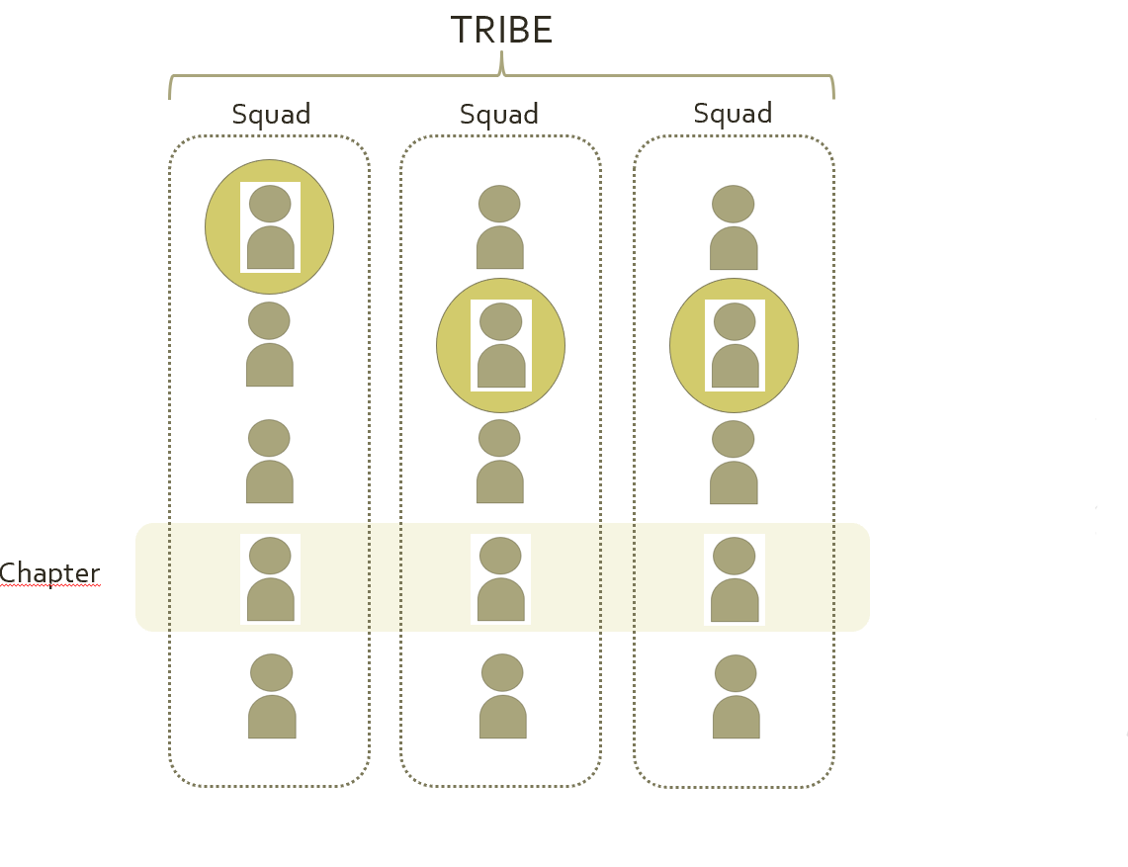
Pillars of Success
Guidelines
Ambassadors
Awareness
Touchpoints
Risk
Guild
Risk
Ambassador
Notes:
So now, how do you begin to ensure proper implementation of Agile from a Risk management perspective. First of all, it does not go by itself, you do not keep doing as before and you rethink your way of working together with the organization. As the organization which you are part of changes, so is also the need for you to change. Agile is a lot about the delegation of responsibilities which means also delegation of part of the Risk Management tasks and knowledge. In order to ensure that risks remain under control, the focus shifts from a ‘second line driven’ control function to a First line control conscious development cycle. In order to get there, significant efforts need to be put into:
Guidelines: you need guidelines and clear ways of working on identifying risk, communicating risks and making them visible for others in the tribe and squad. You need to provide a clear framework of controls to be put in place for which type of risk. Of course you cannot specify evryithing, but that’s where the expert function of a Second line is there.
Ambassadors: you need to train people in order to be your representative in the different change tracks. Knowledge needs to be shared and you need to create a forum in which the ambassadors can share experiences and share knowledge. One in which questions can be raised and escalations can be made.
Awareness: Although the ambassadors are trained, people need to be aware of the risks implicit to developments. They need to be able to recognize risk or at least ask the question to their ambassador or second line.
Touchpoints: you need to provide the forum and regular touchpoints with each tribe or for each Epic (see next slide) upon which the ambassador or squad sits together with the risk function to discuss the state of risks in their developments. The risk mitigation needs to evolve together with development and the user stories mitigating risk need to be delivered together with the Features being launched.

Slide 8
Now…
How do we manage risk in the ‘Change’ track?
Epic
Features
Stories
Tasks
Risk Log
Risk treatment
Notes:
Definition of risk is being done in the 2 top layers, especially when we talk about result risk. Delivery risk can be identified in all layers of Agile as it is linked to the timely / accurate delivery of your change. Risks linked to Compliance, legal, finance, operational risk, continuity, etc. is something which usually can be defined at a more conceptual / higher level.
Nevertheless where your risk is identified, the risk follow-up and mitigation implementation happens in the stories and the tasks. It is therefore essential that the mitigating measures are linked to features when they go live. Your risk management is equally important as the final client deliverable and as such needs to be delivered at the same time. Good risk management = customer value !!

Slide 9
How do we start?
Epic
Features
Epic Risk Rating
Risk Assessments
Notes:
Definition of risk is being done in the 2 top layers, especially when we talk about result risk. Delivery risk can be identified in all layers of Agile as it is linked to the timely / accurate delivery of your change. Risks linked to Compliance, legal, finance, operational risk, continuity, etc. is something which usually can be defined at a more conceptual / higher level.
Nevertheless where your risk is identified, the risk follow-up and mitigation implementation happens in the stories and the tasks. It is therefore essential that the mitigating measures are linked to features when they go live. Your risk management is equally important as the final client deliverable and as such needs to be delivered at the same time. Good risk management = customer value !!

Slide 10
How do I define the Epic Risk rating?
Epic Risk Rating
Project Delivery risks: e.g.
1. Use of new technology
2. Total project budget allocated
3. Extent of organisational change
4. Senior management involvement
5. Proximity of squads / dev team(s)
6. Outsourcing involved?
7. Project governance fully in place?
8. Data migration needs / Decommissioning of legacy?
…
Project Result risks: e.g.
1. External fraud / Cybercrime
2. Internal fraud
3. Possible regulatory impact
4. Possible reputational impact / visibility?
5. Possibilities to roll-back?
6. Data migration implications?
7. Impact to customer satisfaction
8. Consider the data and applications used and evaluate Confidentiality, Integrity and Availability classifications
…
Epic Risk Rating defines the nature and frequency of Risk involvement throughout the Epic

Slide 11
Example

Slide 12
EPIC Risks
Setup of new SRI fund for lower bound investment profiles
Legal
Compliance
Tech
Reputation
Processing
Product catalogue / invest. vehicle
Customer onboarding
Customer presentation channel
Fund Monitoring
Detailed risks
Mitigation actions
Detailed risks
Mitigation actions
Detailed risks
Mitigation actions
Detailed risks
Mitigation actions
Feature Risks

Slide 14
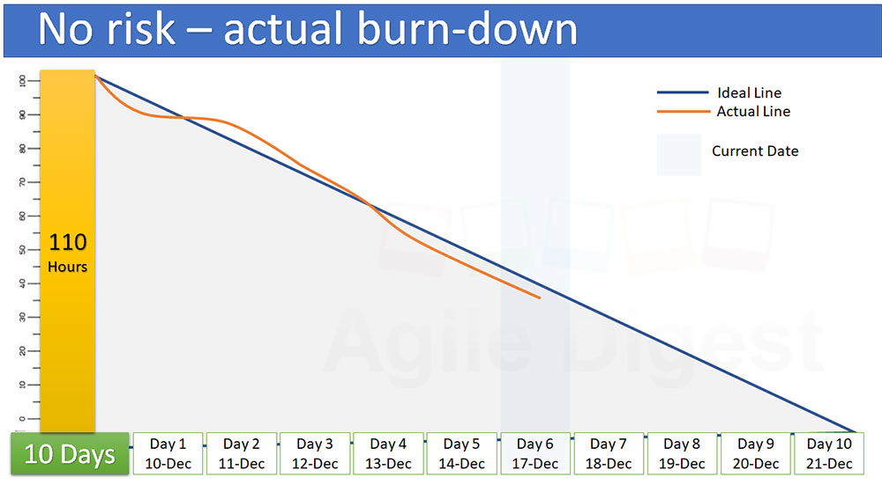

Slide 15
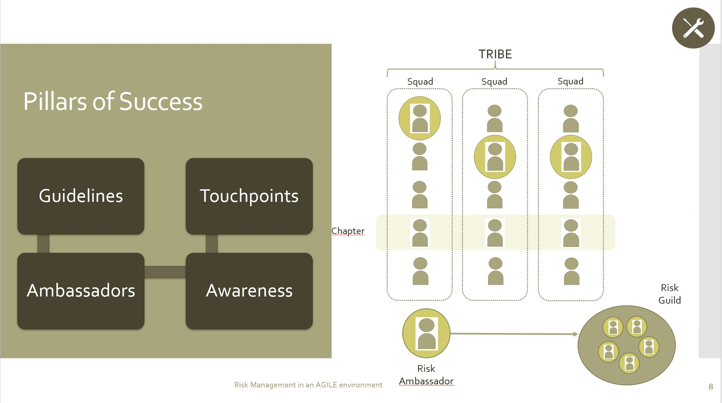
How do we handle all of this???
→ there are tons of features…
→ Responsibilise the 1st Line of Defense
→ Empower the 2nd Line of Defense

Slide 16
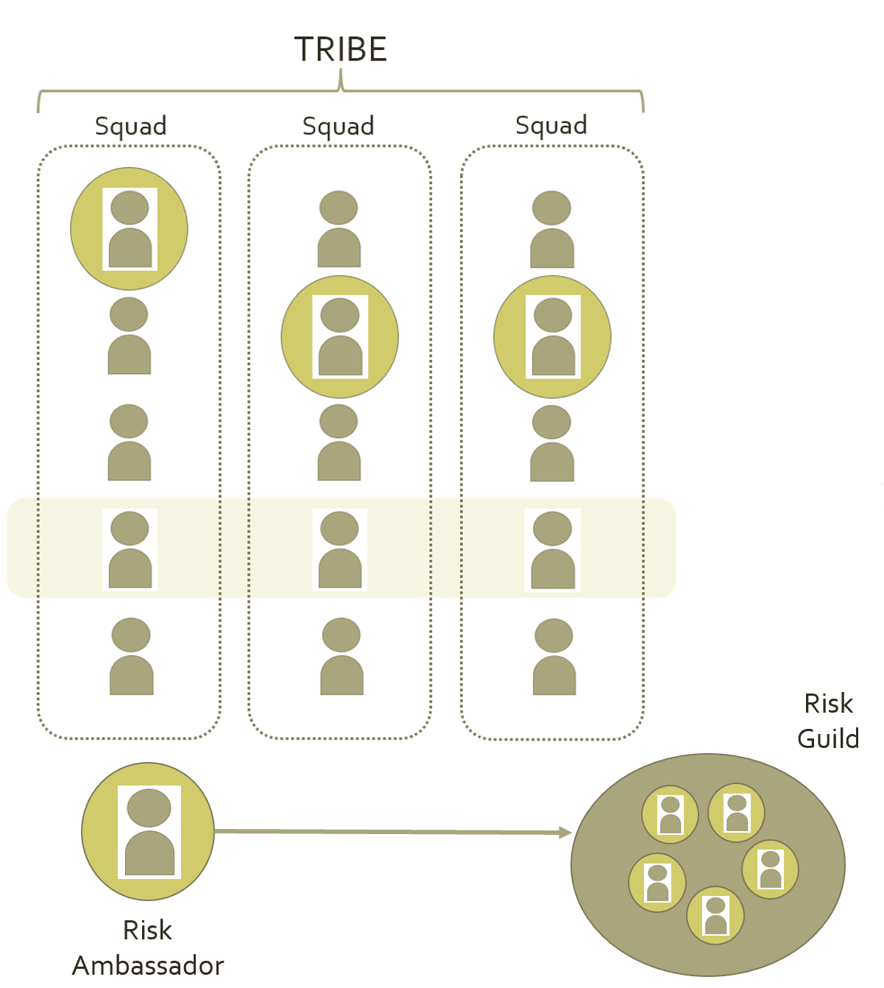
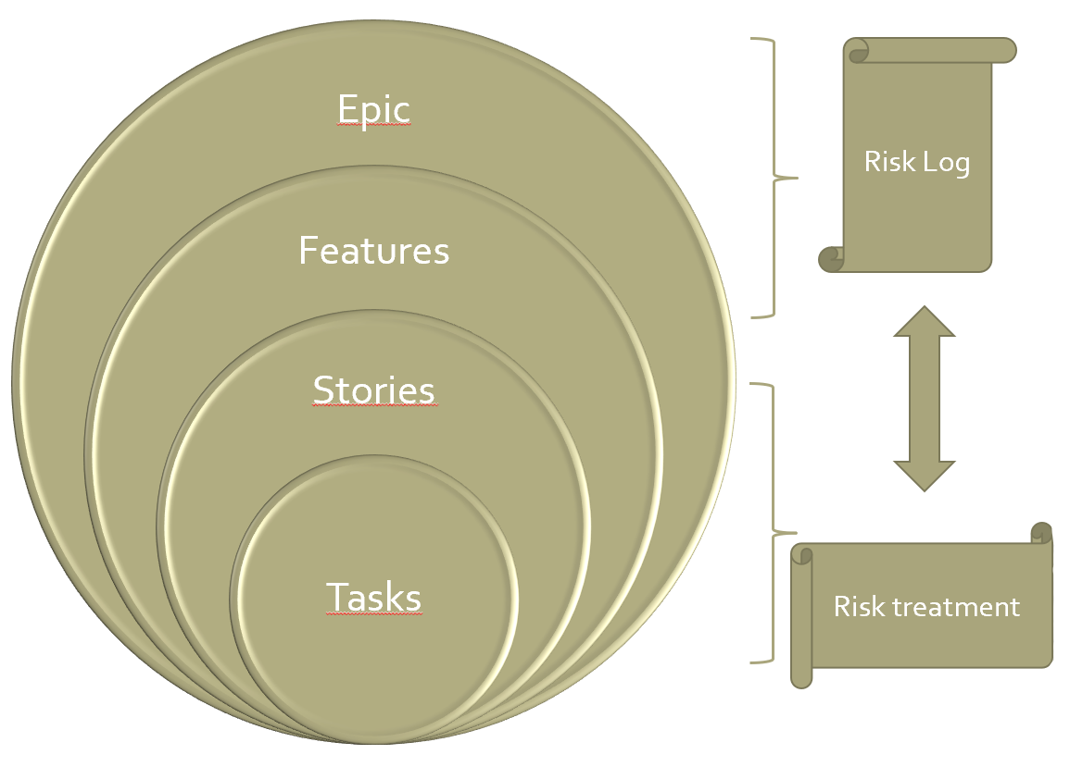
And what exactly is the 2nd LoD doing?
In the Epic risk assessments:
Be a challenger and expert
Ensure all necessary specialists are included
Ensure delivery as well as result risk is assessed
Validate that the process went well
Evaluate risk story Completeness / accuracy in Go / No-Go decision
Validate completion of risk stories linked to features going live (Due diligence)
→ Act as an advisor in the Feature risk assessment + ensure feedback loop to the Epic

Slide 17
Key take-aways
What do I need to mind?
Be open to change your way of working
LEAN your Risk-process(es)
Understandable and well-founded Policies and guidelines
Provide proper training to your first line through the ambassadors
Risk management embedded at all levels
Install / be embedded in ‘tollgates’
Identify your ‘result risks’* on Epic / feature level and let it dripple down and reported upwards
Changes are deployed accross the organization, you can’t do it all yourself, so:
  Create ambassadors
  Train them
  Delegate responsibility
  Set up adequate reporting / touchpoints
* See slide in annex

Slide 18

Thank you
S.A.M. Consulting – Kaevin Rombaut
Kaevin@telenet.be
+32 476 67 27 92

