Slide 1
IMIF – Internal Model Industry Forum – Welcome
Phil Whittingham
Head of Model Validation and Risk Governance, XL Catlin
IMIF Chairman

Slide 2
IMIF Purpose and Objectives: Creating value through internal models
Understanding challenges for the insurance industry in complying with Solvency II regulation for Internal Models
Understanding the stage of maturity of industry in embedding Internal Models, as a key tool of risk and capital evaluation
Identifying the current gaps and best practices in the Industry
Ensuring alignment in the industry including good balance between pragmatic solutions and regulatory requirements
Enabling a communication channel with the regulator, industry associations (e.g. IRM, IFoA, ABI) and other stakeholders (i.e. consulting firms).

Slide 3
IMIF scope and key topic areas
VALIDATION FRAMEWORK (IMV)
USE OF INTERNAL MODELS (IM)
METHODOLOGY
CULTURE & TRANSPARENCY

Slide 4
A strong industry forum
Over 40 life and non-life insurance players represented
Over 400 forum members

Slide 5
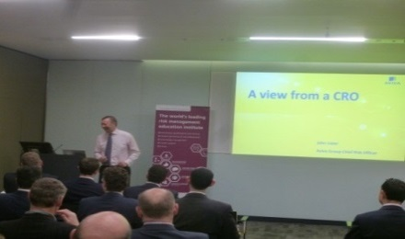
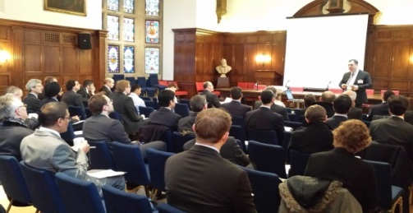
The IMIF’s contribution so far
Kick off meeting June 2014
30 Steerco meetings
10 workstreams
9 Forum meetings
6 booklets
4 ‘use’ case studies
2 Industry surveys
1 webinar
Speaking opportunities
Articles in the press

Slide 6
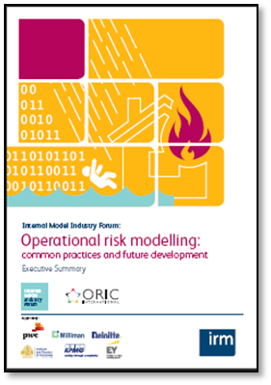
IMIF published guidance

Slide 7
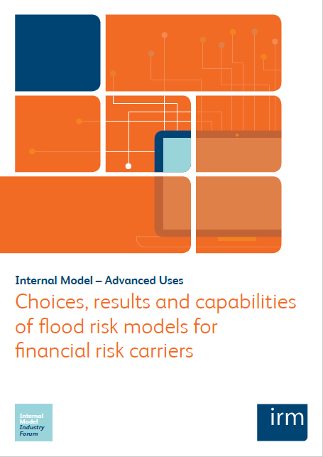
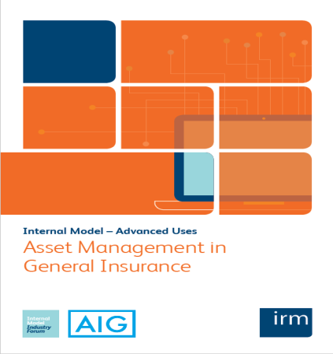
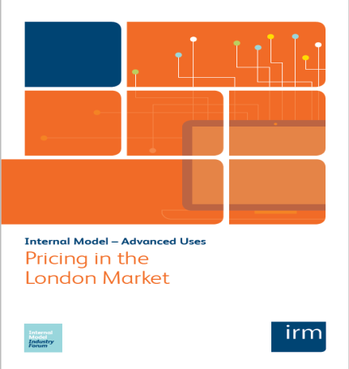
Advanced uses of internal models – case studies

Slide 8
2017 and beyond
First wave of internal model approvals is complete
International regulation continues to develop
Objectives set out in 2014 remain relevant

Slide 9
Expanding delivery
Continue with White Papers
Continue with surveys
Build roundtables to increase dialogue between regulators and industry
Introduce published roundtables to raise awareness of key topics

Slide 10
Topics for 2017/2018
Competencies for Validation function
Questions for Non-Executives
Lessons learnt on Board validation reports
From validation to model risk
Future of Internal models
Lessons learnt from IMAP

Slide 11
Questions?
For Information: www.theirm.org/imif

Slide 12
Internal Models – A NED/board level perspective
Ian Marshall, PRA Senior Adviser

Slide 13
Profit & Loss Attribution the road ahead
Russell Ward

